Slide 1
Next Generation Catalogue
RDF as a Basis for New Services
Asgeir Rekkavik (Librarian) and Anne-Lena Westrum (Project Manager)
Oslo Public Library, Norway
@digibib | digital.deichman.no | github.com/digibib

Slide 2
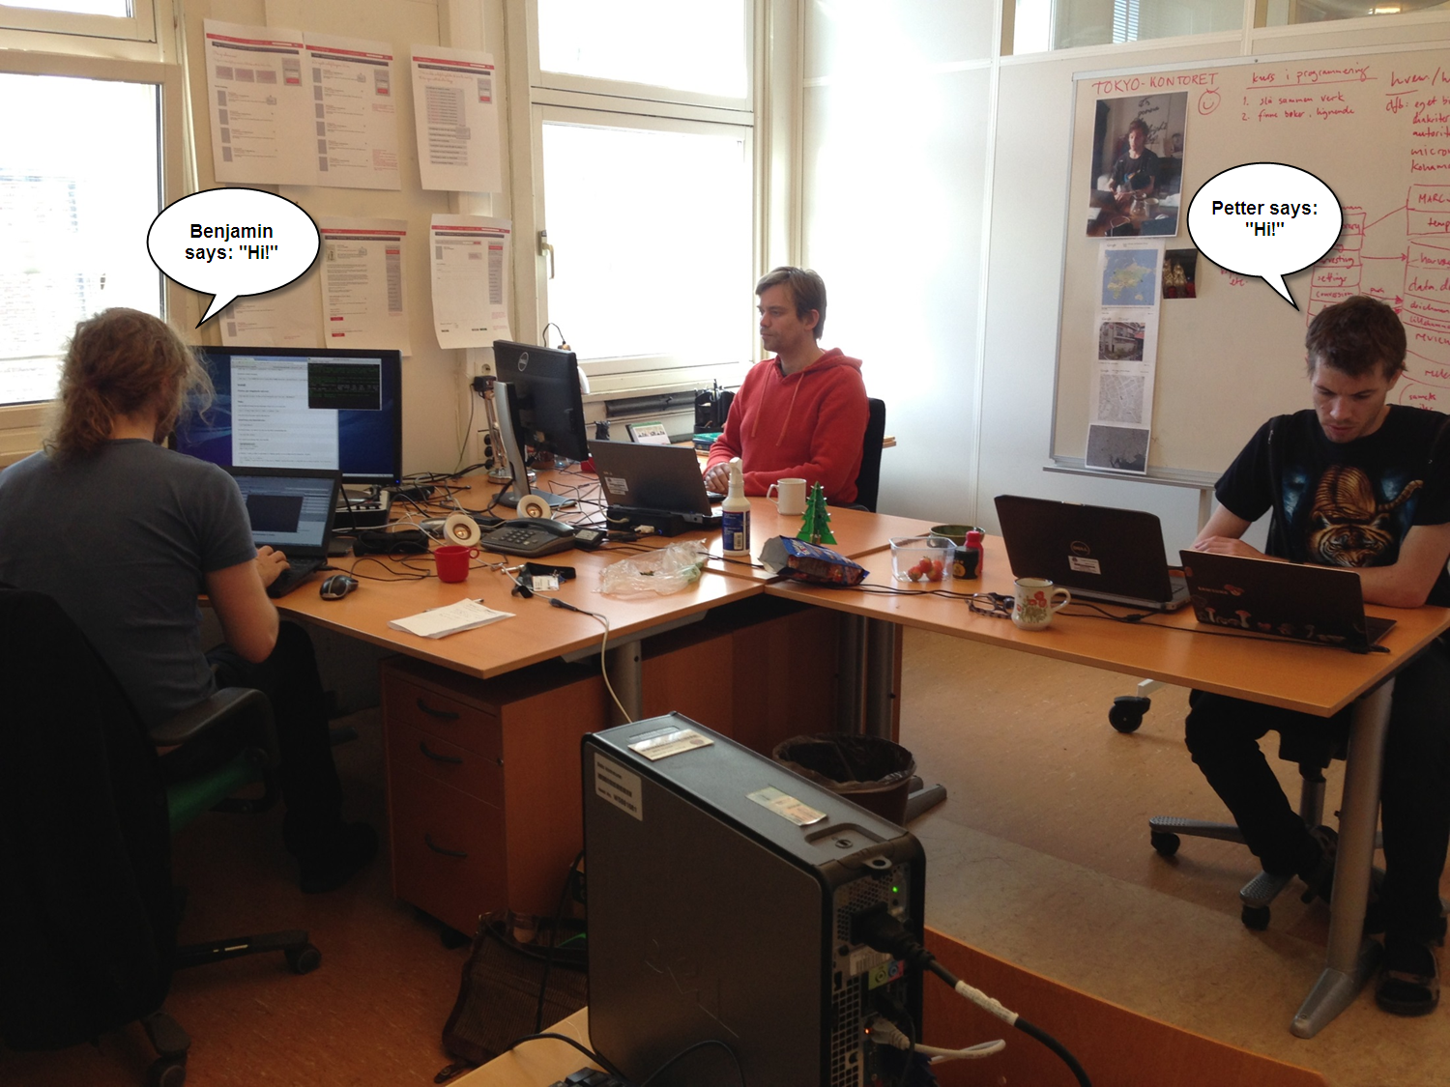
Digital Development Team

Slide 3
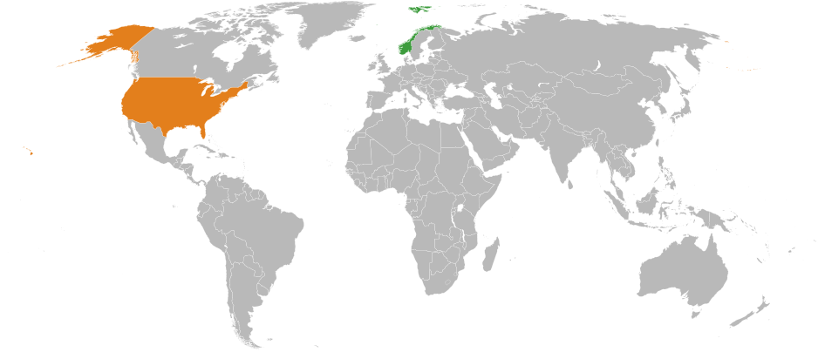

Slide 4
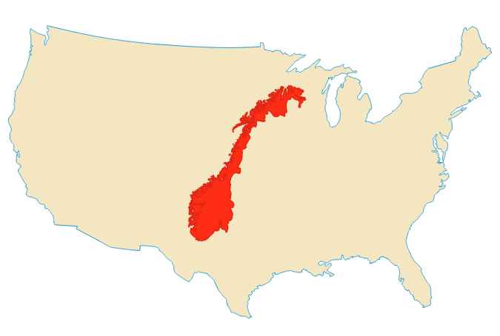

Slide 5
M
4 years ago

Slide 6
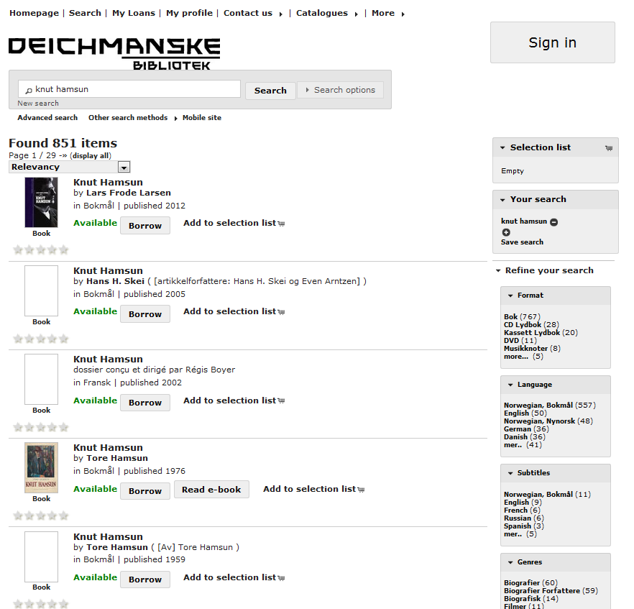
Search for Knut Hamsun
851 vs 40

Slide 7
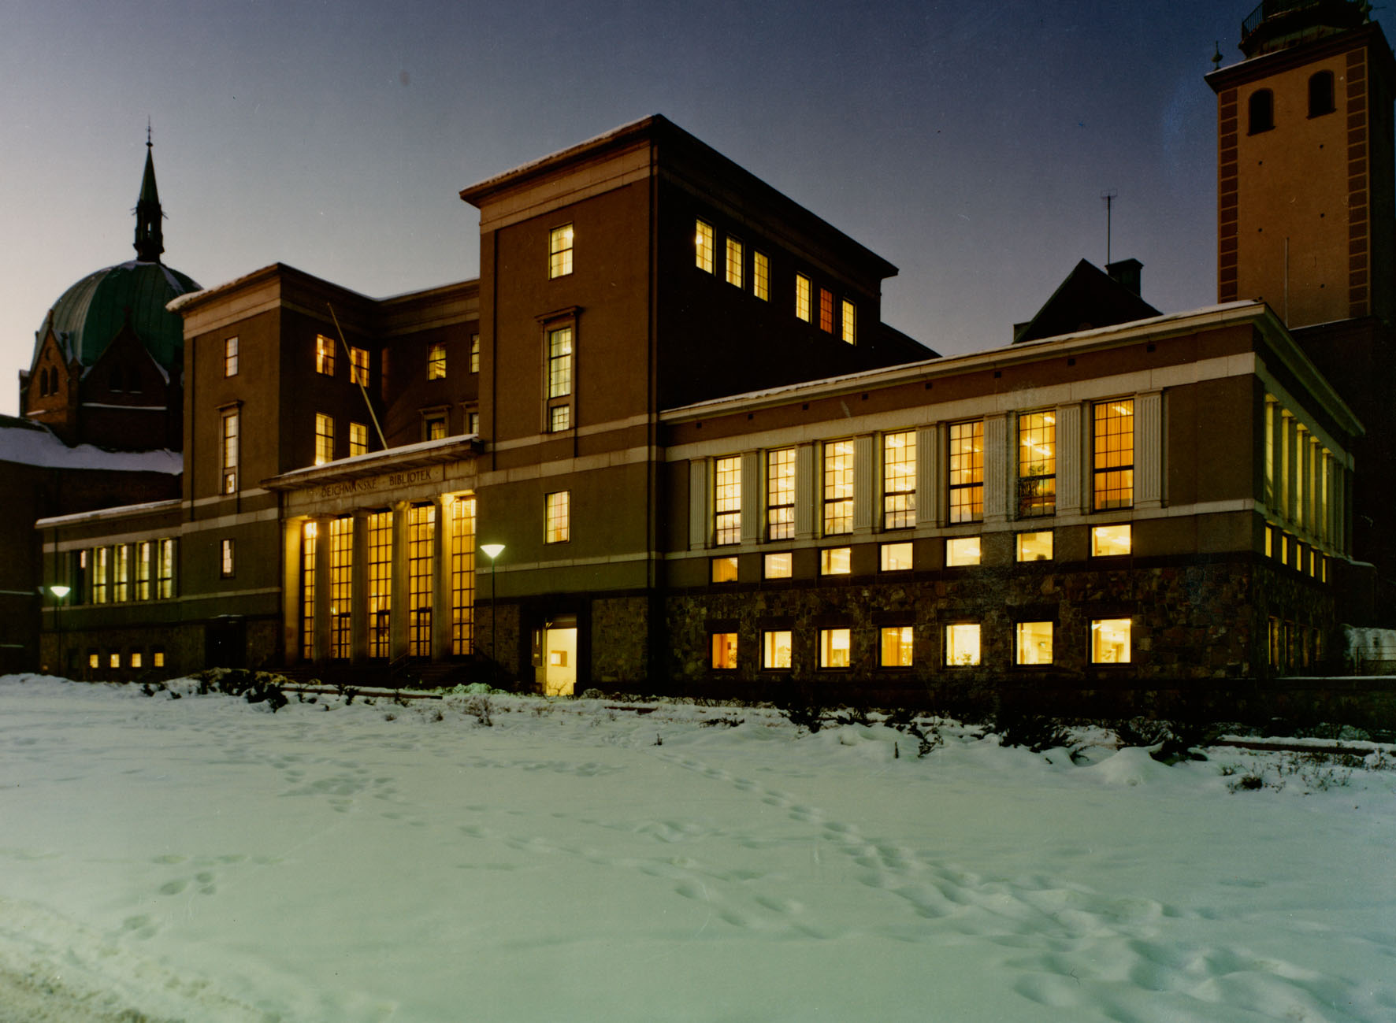
Now

Slide 8
In 2017

Slide 9
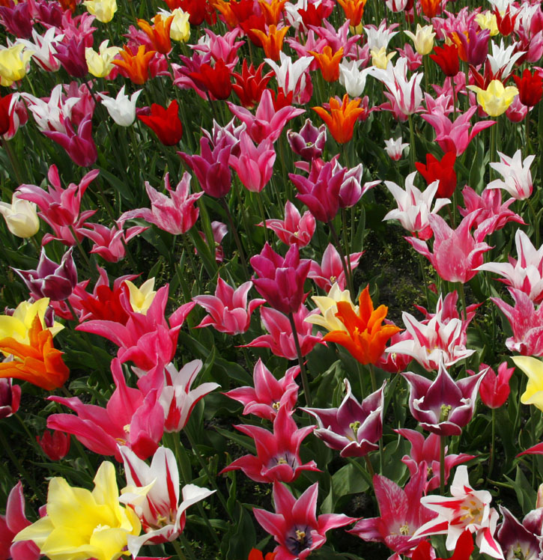

Slide 10
Active shelves

Slide 17
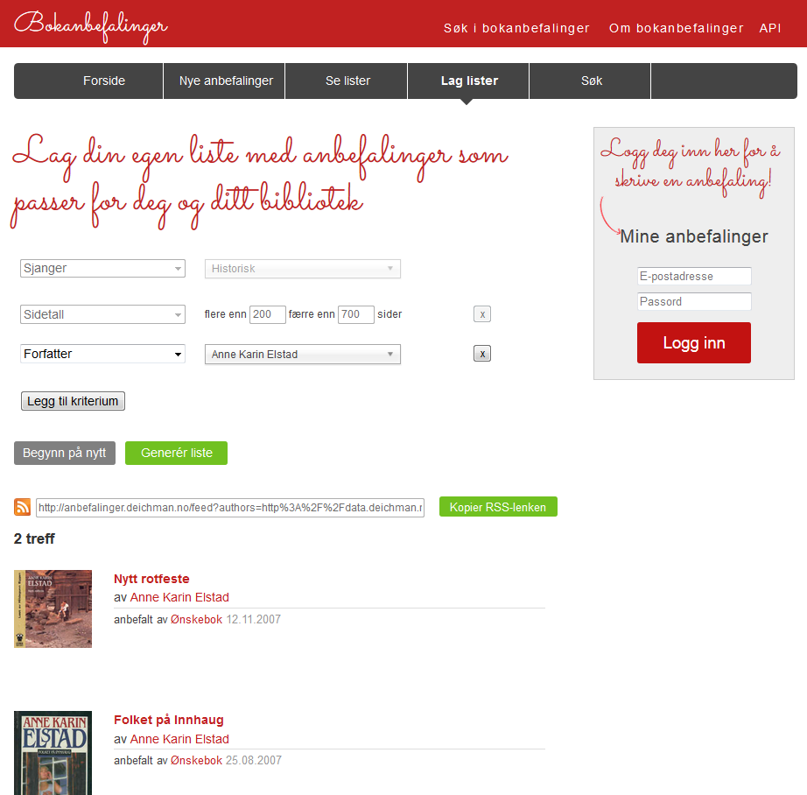
Book recommendations

Slide 18
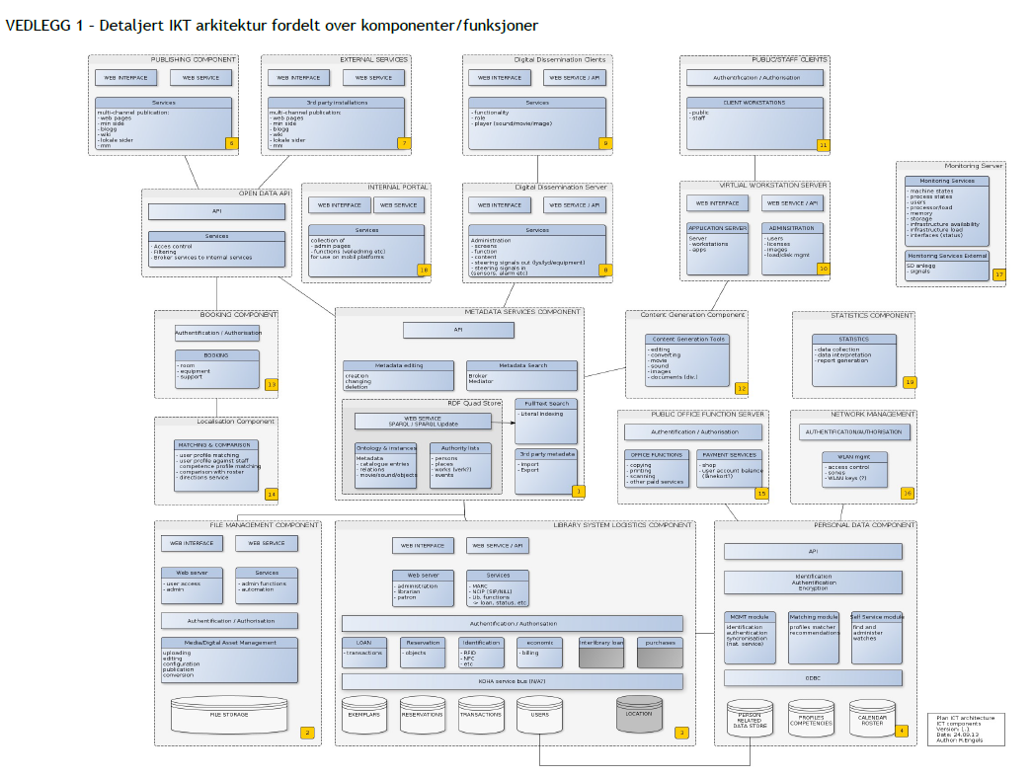
From To

Slide 19
Preparing for the future
A new foundation

Slide 20
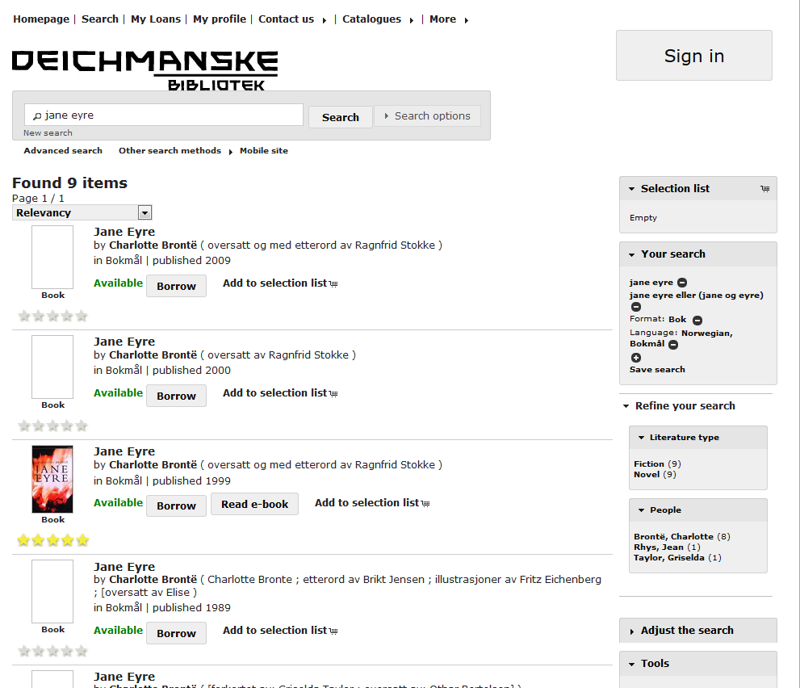

Slide 22
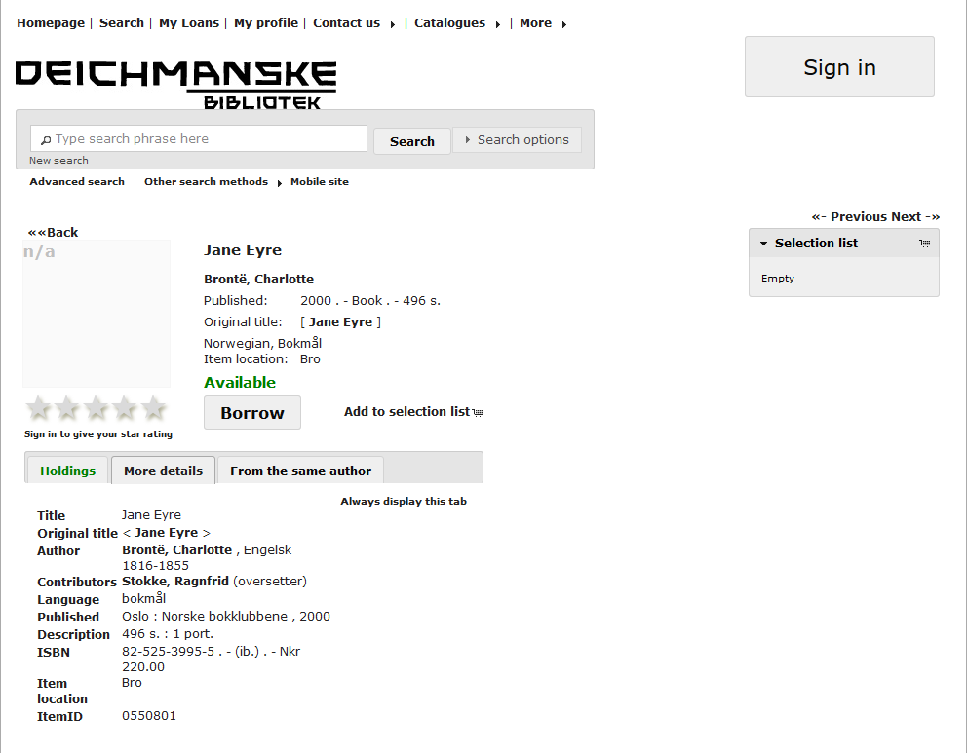

Slide 23
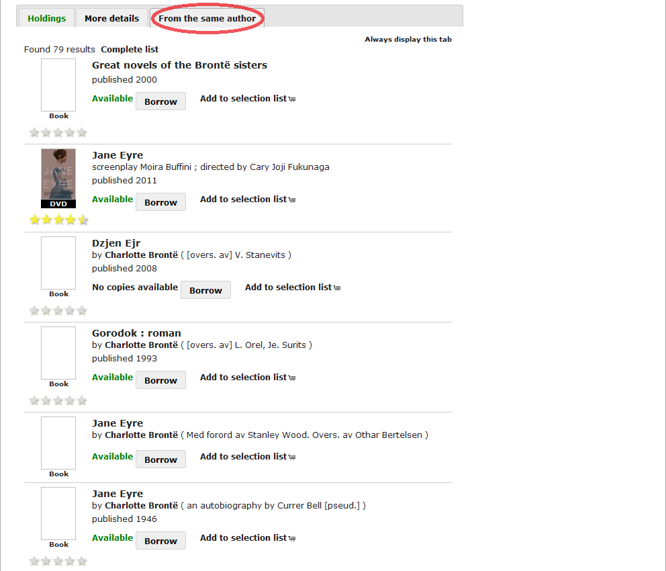

Slide 24
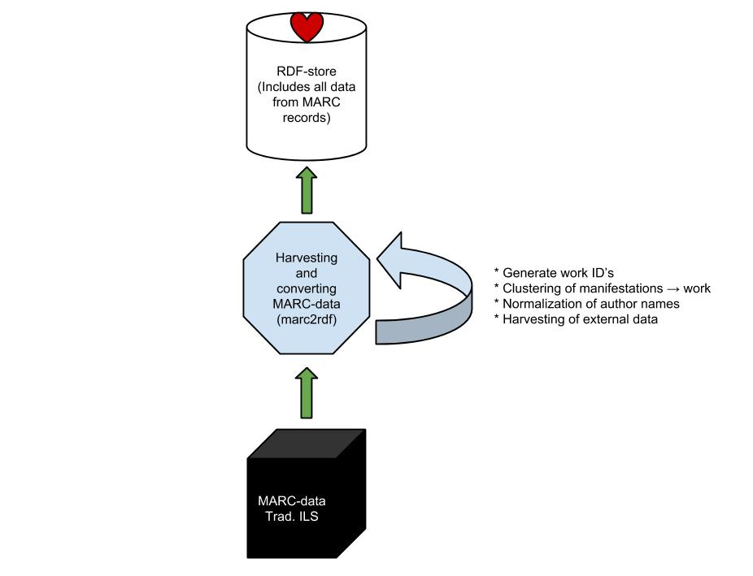
From MARC to RDF

Slide 25
marc2rdf

Slide 26
Open source toolkit for producing an RDF representation of the library catalogue
https://github.com/digibib/marc2rdf

Slide 27
Plain conversion: MARC bibliographic data → RDF
https://github.com/digibib/marc2rdf

Slide 28
SPARQL methods for modifying data and clustering by work
https://github.com/digibib/marc2rdf

Slide 29
Enriching catalogue data with external content from various APIs and Linked Open Data, such as cover images and book reviews → marc2rdf
https://github.com/digibib/marc2rdf

Slide 30
<http://data.deichman.no/resource/tnr_504318> a fabio:Manifestation ;
dct:language <http://lexvo.org/id/iso639-3/eng> ;
dct:creator <http://data.deichman.no/person/x2039156200> ;
dct:title "Jane Eyre" ;
deich:titleURLized "jane_eyre" .
<http://data.deichman.no/resource/tnr_397790> a fabio:Manifestation ;
dct:language <http://lexvo.org/id/iso639-3/vie> ;
dct:creator <http://data.deichman.no/person/x2039156200> ;
dct:title "Kieu giang" .;
deich:titleURLized "kieu_giang" ;
deich:originalTitle "Jane Eyre" ;
deich:originalTitleURLized "jane_eyre" .
Base URI: http://data.deichman.no/work/
Creator ID: x2039156200
(Original) title: jane_eyre
<http://data.deichman.no/work/x2039156200_jane_eyre>

Slide 31
rdf2marc

Slide 32
From MARC to RDF

Slide 33
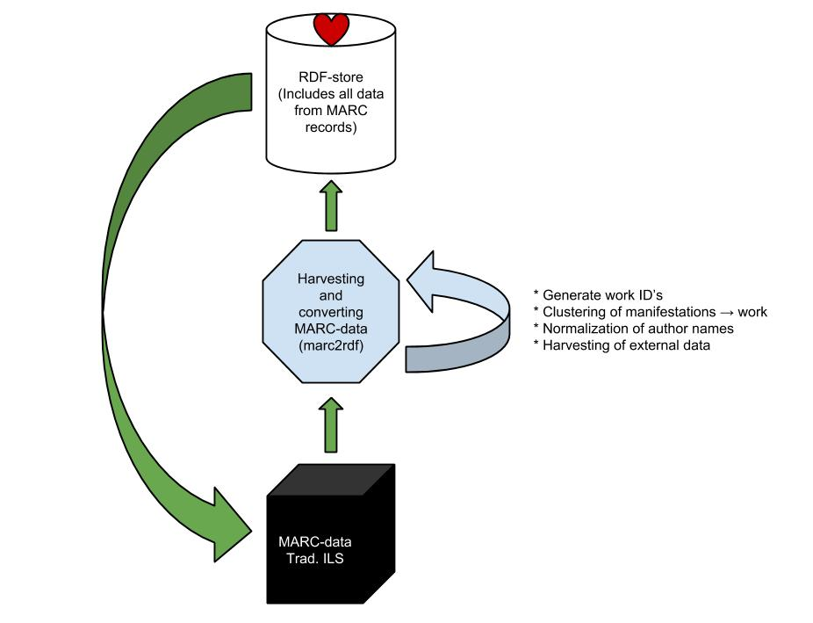
Goal

Slide 38
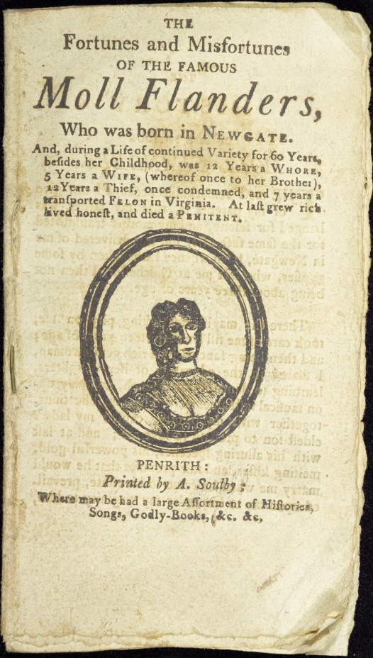

Slide 39
Thank you! ☺
http://digital.deichman.no/
https://github.com/digibib
@digibib

