Slide 1
BUILDING FOR OTHERS
AND OURSELVES
Michael Klein & Julie Rudder Northwestern University Library
Notes:
Hi, I’m Julie Rudder, I’m a project manager at Northwestern University and a co-product owner for Avalon Media System.
Michael Klein intro himself

Slide 2
What is Avalon?
2

Slide 3
What is Avalon?
an open source project
a digital audio/video management and delivery system
a product focused on needs of libraries and archives
3
Notes:
The Avalon Media System is an Hydra-based open source system for managing and providing access to large collections of digital audio and video. We’ve had two releases so far, and are a couple weeks away from our third release.

Slide 4
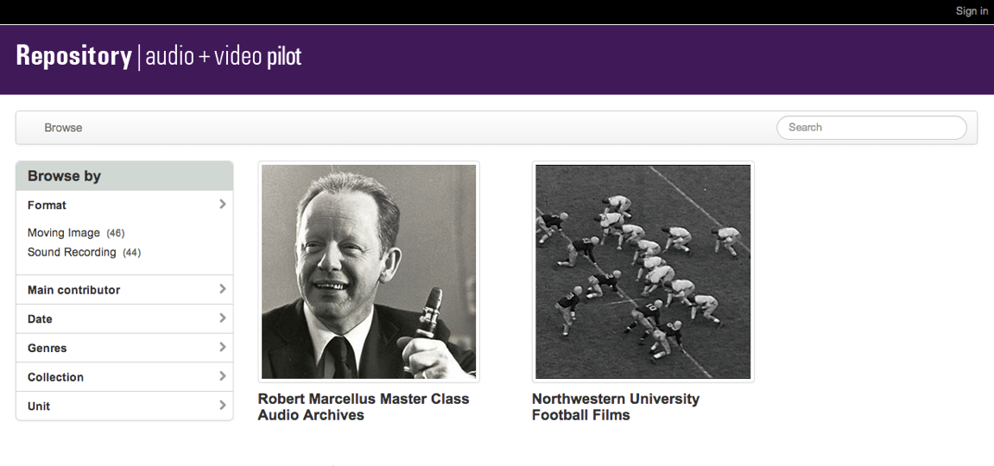
What is Avalon?
an open source project
a digital audio/video management and delivery system
a product focused on needs of libraries and archives
Northwestern’s Avalon Pilot
4
Notes:
This is an image of Northwestern’s Avalon Pilot’s and what you can’t tell is that what Avalon does is allows you to ->

Slide 5
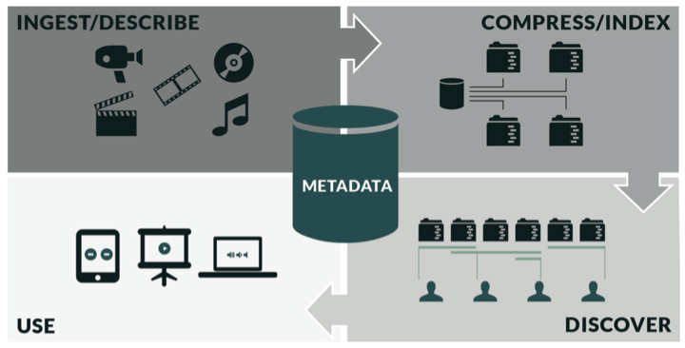
5
Notes:
ingest and describe content and then on the backend, Avalon transcodes the media and makes 3 smaller derivatives to be discovered and used in the classroom or on their mobile devices, etc.

Slide 6
(some) Avalon Goals
create an open source system to enable libraries and archives to
provide online access to video and audio collections
leverage existing technologies, where feasible
communicate and market the project broadly to increase awareness
and grow the community of users and developers
6
Notes:
So with Avalon we have always set out to build a product that would be widely adopted by many institutions. So today we are going to talk about how we have approached building a system with this other institution in mind and balancing that with filling our own institutional needs. At Northwestern, we have been delivering secure media streams since 2004 and we have an outdated video streaming infrastructure and we are really excited to be launching this is production at Northwestern next month. And looking forward even more to retiring our Helix server. In other words, we need Avalon.

Slide 7
Avalon Community
development partners since 2012
& funding from the:
7
Notes:
So since 2012, Northwestern and Indiana University have been developing Avalon together with funding in part from an IMLS grant.

Slide 8
Avalon Community
8
Notes:
We also have 9 institutional partners who are committed to pilot and contribute to Avalon

Slide 9
Avalon Community
9
Notes:
And we are a part of two technology communities, Project Hydra which is what Avalon is built on and Opencast Matterhorn which does the media transcoding and job queuing.

Slide 10
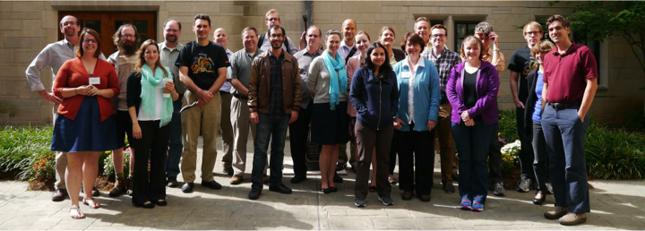
Community feedback is important, so we ask...
how are we doing?
what is missing?
what else do you need?
Partner Meeting last October in Bloomington
10
Notes:
So since we really want people to install and use Avalon, one of the things we do is reach out to you and ask you, How are we doing? What functionality is missing? What else do you need? We do that through talking to people, through surveys and most recently we hosted a two day partner meeting in Bloomington, Indiana. These conversations shape our general direction and our immediate priority list.

Slide 11
One major theme we heard was
“ We need integration with Learning Management Systems”
11
Notes:
For example, one thing that wasn’t on our near term priority list was integration with Learning Management Systems. So coming out of the October partner meeting, we revisited our next planned release and added

Slide 12
LTI
(Learning Tools Interoperability)
12
Notes:
Created an Avalon LTI. It turns out that this really helps our local implementations. We really needed the ability to limit access to resources to members of specific course. The LTI allows us securely share media to people in a course without having to tackle the bigger feature of integrating with external course membership feeds. That certainly would have required more time to design and build.

Slide 13
Requirements if we were doing this alone:
“LTI has to work with Sakai”
13
Notes:
If we were not building this with others in mind, we would have stopped here. LTI has to work with Sakai. The reason this is important is because each LTI tool consumer (the LMS, blackboard etc) has it’s own way of presenting its user and course specific fields to the tool provider (which is Avalon). So what works for one LMS does necessarily work for another.

Slide 14
Requirements with you in mind:
“LTI should work well with any system that has LTI support”
14
Notes:
But as Indiana’s LMS is Sakai and Northwestern uses Blackboard and Canvas and there are other LMS’s out there...now it’s configurable. If we would have just been building for ourselves we would have stopped with what worked with Sakai, that would have been faster AND easier.

Slide 15
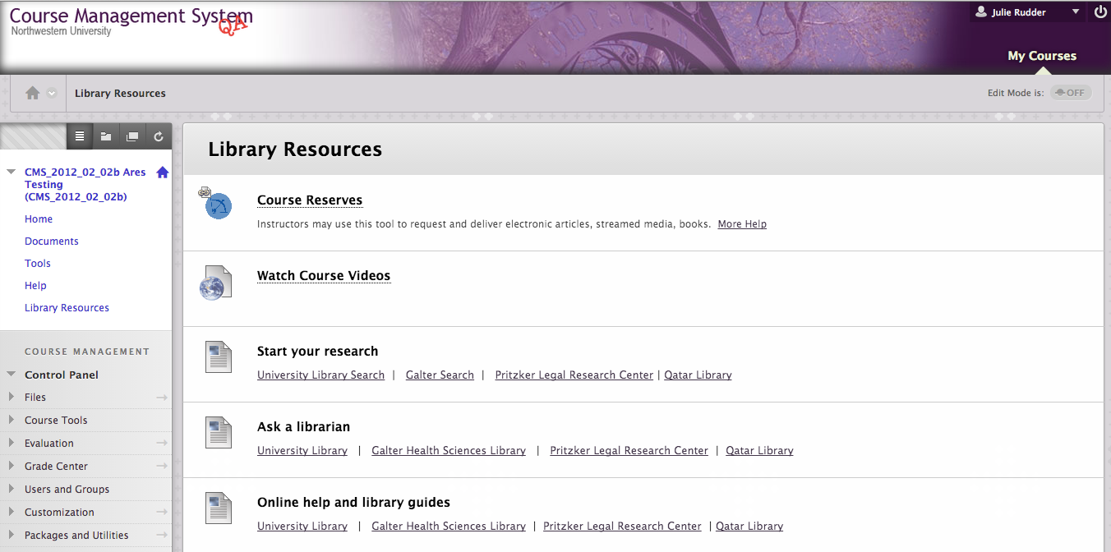
Blackboard view of Avalon LTI
15

Slide 16
Blackboard view of Avalon LTI
16
Notes:
Here is a view of the LTI

Slide 17
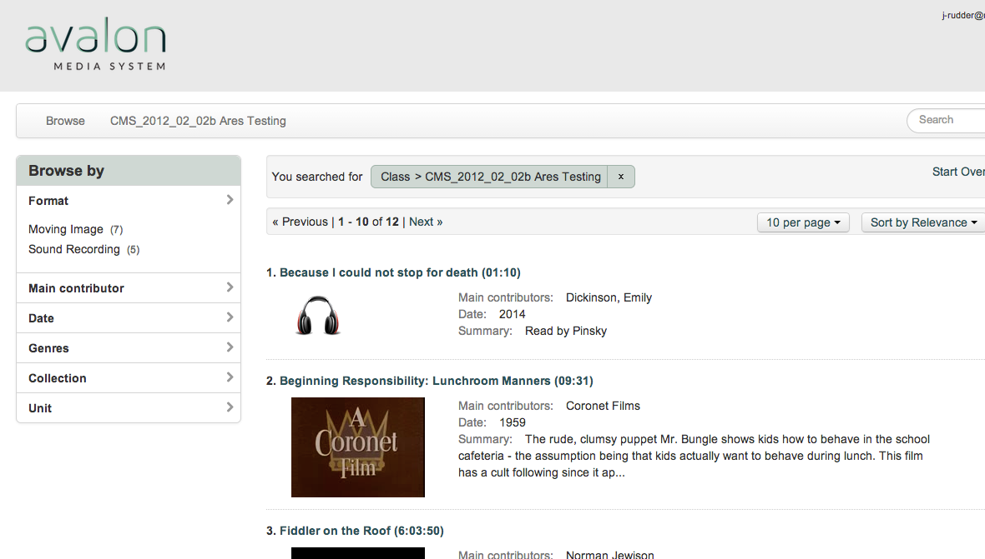
Avalon course view via LTI
17
Notes:
So once a student or a faculty clicks on the LTI link in their LMS, their credentials are passed to Avalon, so they are already logged in and they see a course specific view of Avalon. Had we not made the LTI configurable, Blackboard would have passed this course name as a big nasty number that would not be workable for our reserve staff, nor our end users.

Slide 18
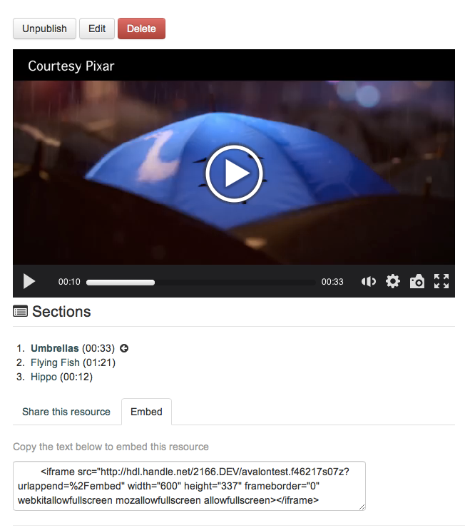
Embedding Avalon resources: Embed code in Avalon view
18
Notes:
Another strategy we use to prioritize our work is to think about expected features and behavior. For example: one feature that we moved up the priority line is embedding video. And we think often about expected features when we are prioritizing work for upcoming releases. It’s very important for people to use the system so we can get good feedback. Adding this specific feature made Avalon more attractive to some non-library units that would be using Avalon at Northwestern.

Slide 19
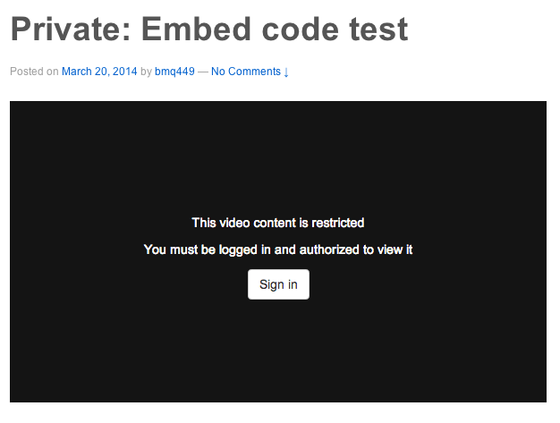
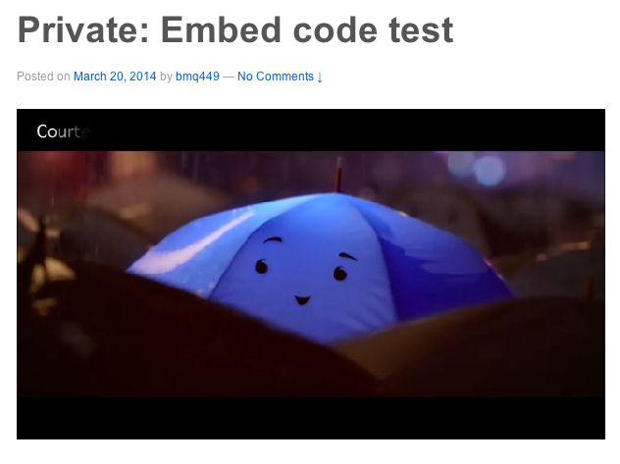
Wordpress view: restricted Avalon resource
19
Notes:
So here’s what a restricted resource looks like within a Wordpress site

Slide 20
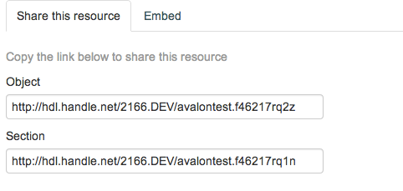
Permalinks
NU: Handle.Net Handles
20
Notes:
Adding handle support was a high priority for Northwestern’s implementation, since so many of the video resources we will be migrating from our legacy video system already have handles assigned. We plan to migrate those handles to point to the same resources once they’re in Avalon.

Slide 21
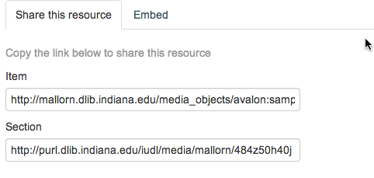
Permalinks
IU: Internal PURLs
21
Notes:
Limiting durable URL support only to handles, however, would have been a major limitation for institutions that use other types of durable URLs.

Slide 22
Installation
many individual components
potentially spread over multiple servers
each component has its own configuration requirements
22

Slide 23
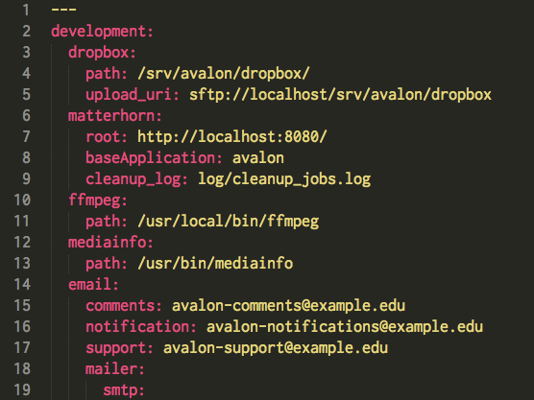
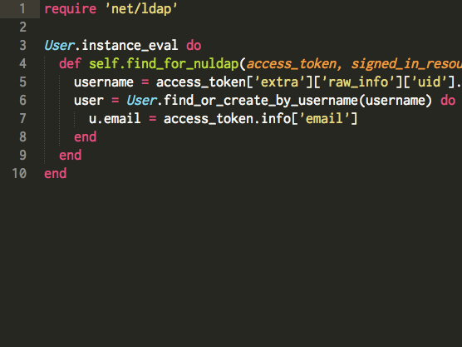
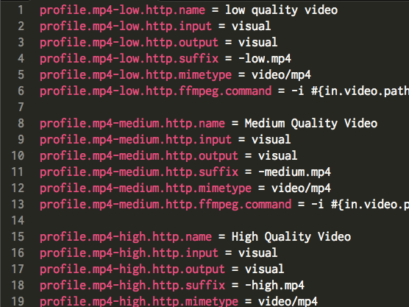
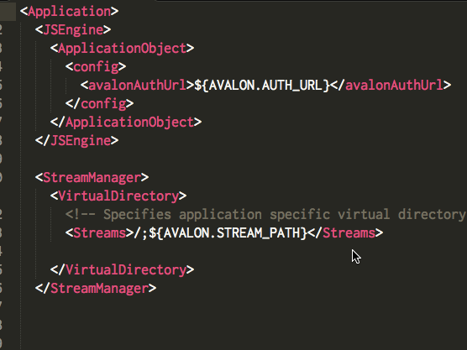
Configuration
23
Notes:
YAML, Ruby, Java .properties, XML

Slide 24
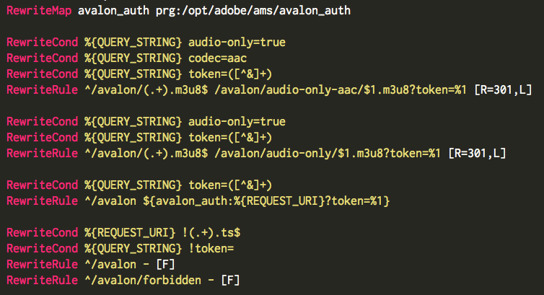
Configuration
24
Notes:
I wasn’t gonna throw up our mod_rewrite, but since Dre went there...

Slide 25
Configuration vs. Code
LTI: Configuration
Permalinks: Code
User Authentication: Some of each
25

Slide 26
LTI: Configuration
26

Slide 27
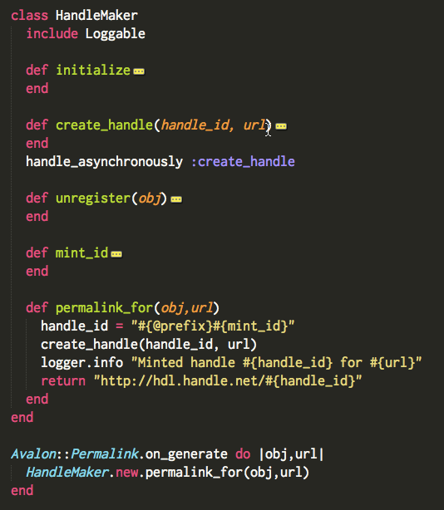
Permalinks: Code
27

Slide 28
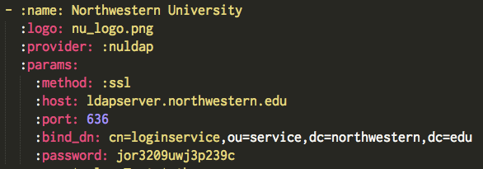
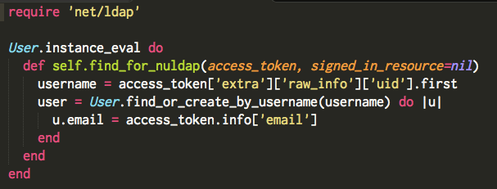
User Authentication: Both
28

Slide 29
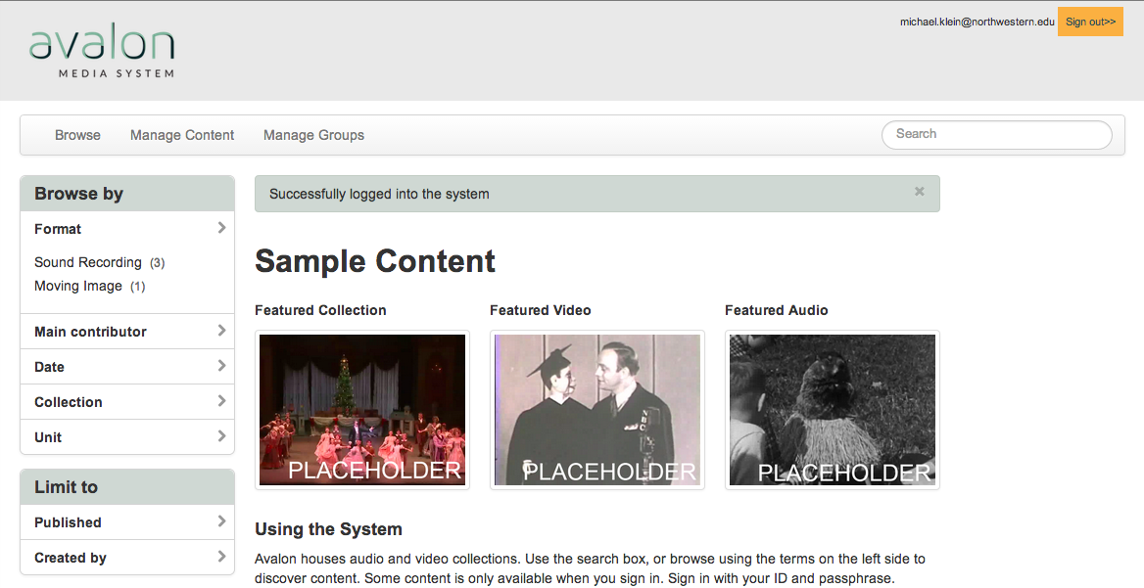
Customization
29

Slide 30
Customization
30

Slide 31
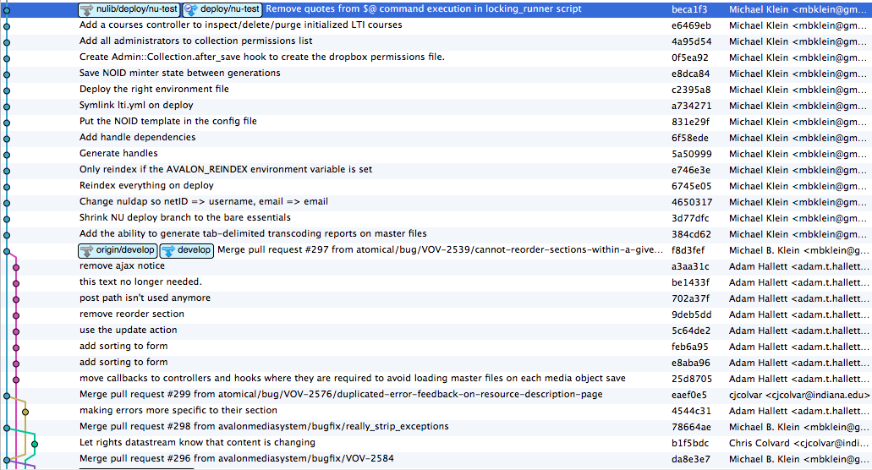
Customization
31

Slide 32
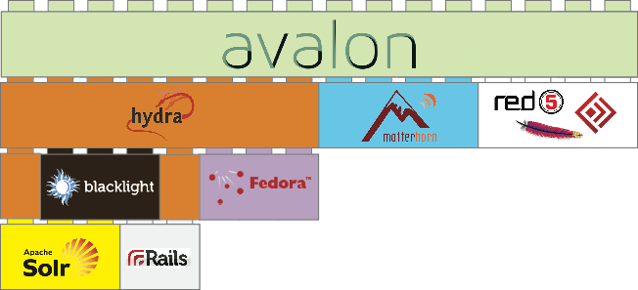
Technology Stack
Integration with:
LMS
Websites
Authn/Authz
Archival Storage
Permalinks

Slide 33
Installation Dependencies
33

Slide 34
Installation Dependencies
34
Notes:
This is what the installation dependency graph makes me feel like

Slide 35
Installation Dependencies
35
Notes:
Goal: Turn the squid into a friendly Emoji octopus

Slide 36
So with you in mind, we build...
Admin-friendly installers
With abstraction and customization
Based on shared priorities
36

Slide 37
Multiple Distributions for Different Needs
Puppet Manifest
Vagrant VM Installer
OVA Portable Virtual Machine
37

Slide 38
Community
38
Notes:
We are looking to build the community, both for people who just want to use avalon and for those who want to contribute back, code or otherwise. We have just started to work out a process for this. We always welcome feedback and questions.

Slide 39
avalonmediasystem.org
39
Notes:
So please visit our website where you can find out more about how to try out Avalon and I recommend signing up for our listserv so you can find out about releases, webinars, etc. Do it now because Version 3 due out soon.
We also have stickers!

