Slide 1
We are All Disabled! Making Your Part of the Web Accessible
Cynthia Ng
@TheRealArty
Code4Lib 2014

Slide 2
bit.ly/c4l14-arty

Slide 3
CC BY ND http://www.flickr.com/photos/tambako/3443007398/

Slide 4
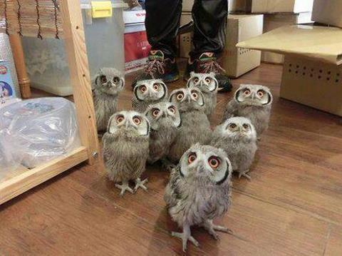
https://twitter.com/CuteEmergency/status/444844255329411072/photo/1

Slide 5
CC BY NC http://www.flickr.com/photos/hunty66/390350345/

Slide 6
CC BY NC http://www.flickr.com/photos/luckyno3/8262860521/

Slide 7
What is Web Accessibility?

Slide 8
- W3C Web Accessibility Initiative (WAI)
Web accessibility means that people with disabilities can use the Web.
http://www.w3.org/WAI/intro/accessibility.php

Slide 9
http://wall.alphacoders.com/by_sub_category.php?id=217856

Slide 10
Why Should You Care?

Slide 11
Disability >
Largest
Visible Minority
Based on the USA 2010 Census & Canada 2006 Census

Slide 12
That’s a Lot of People

Slide 13
The Rehabilitation Act

Slide 14
Web Content Accessibility Guidelines (WCAG)

Slide 15
We want to help.
CC BY-NC-SA http://www.flickr.com/photos/lalalaurie/3620744384/

Slide 16
How Do We Develop for People with Disabilities?

Slide 17
What is Assistive Technology?

Slide 18
- Wikipedia
An umbrella term that includes [...] devices for people with disabilities [...] by enabling people to perform tasks that they […] had great difficulty accomplishing, by […] changing methods of interacting with the technology needed to accomplish such tasks.
http://en.wikipedia.org/wiki/Assistive_technology

Slide 19
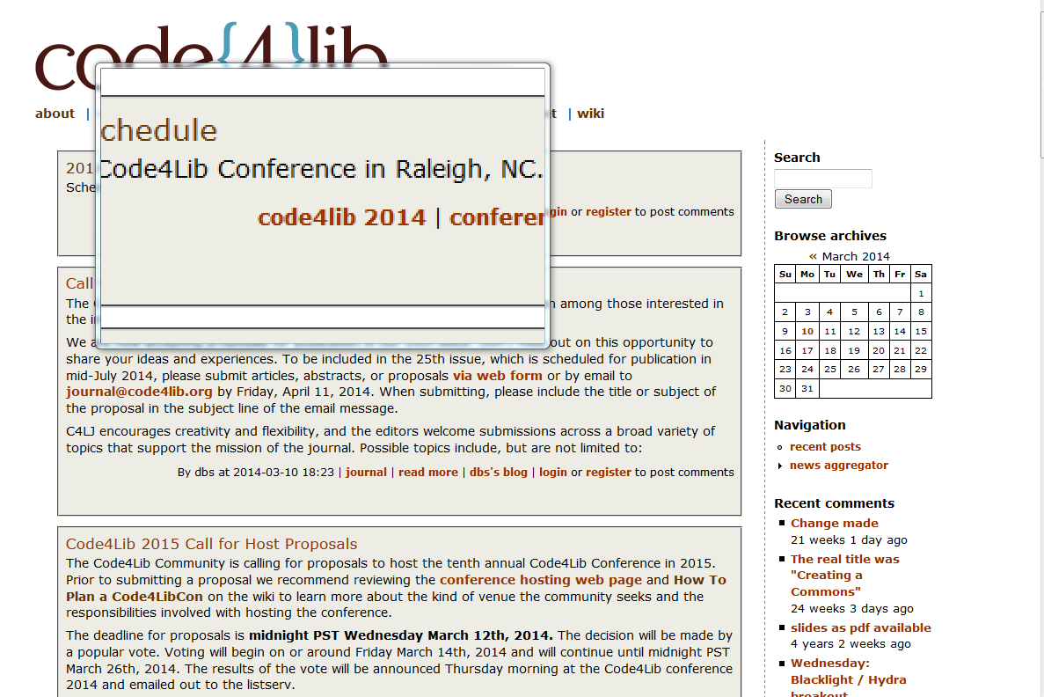

Slide 20
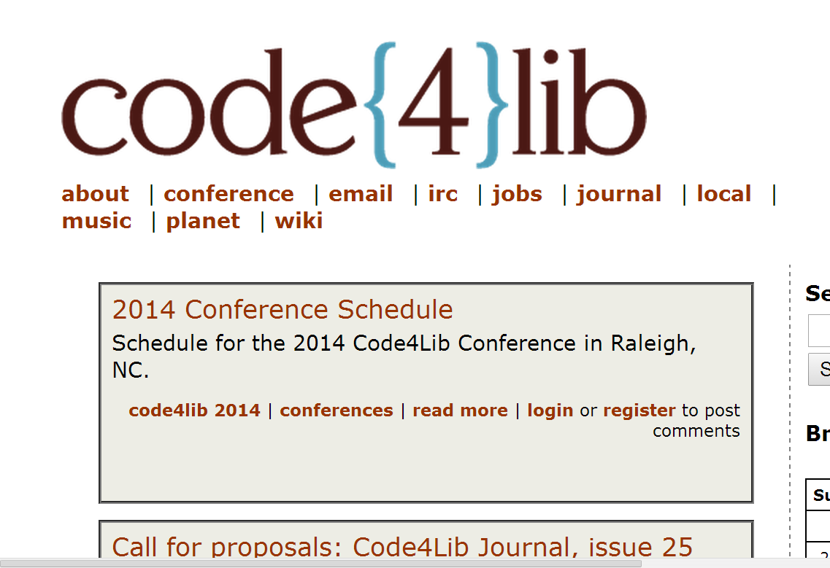

Slide 21
CC BY http://www.flickr.com/photos/mapkyca/4520689090/

Slide 22
CC BY NC SA http://flickr.com/photos/michaelfitz/3490322415

Slide 23
CC BY http://www.flickr.com/photos/jetalone/4694268229/

Slide 24
- Sara Hendren @ablerism
All Technology is
Assistive Technology
https://medium.com/thoughtful-design/a8b9a581eb62

Slide 25
There is no average user.

Slide 26
http://www.animoca.com/en/2012/05/all-the-myriad-androids/

Slide 27
The Solution?

Slide 28
- Debra Riley-Huff @rileyhuff
Move away from the approach of building separately for disabled users, and concern yourself with creating clean, beautiful, usable, and accessible websites.
Riley-Huff, D. A. (2012). Web Accessibility and Universal Design. Library Technology Reports, 48(7), 29-35.

Slide 29
Universal Design

Slide 30
- Ron Mace
Universal design is the design of products and environments to be usable by all people, to the greatest extent possible, without the need for adaptation or specialized design.
http://www.ncsu.edu/ncsu/design/cud/about_ud/about_ud.htm

Slide 31
CC BY NC ND http://www.flickr.com/photos/maziarh/7216119402/

Slide 32
Guidelines for All
consistent navigation,
meaningful order to content, and
provide multiple ways to discover content

Slide 33
The Center for Universal Design. The Principles of Universal Design, Raleigh, NC: North Carolina State University. http://udlhcpss.wordpress.com/historical-foundations/

Slide 34
Putting Universal Design into Practice

Slide 37
CC BY NC SA Slide 38 of http://matthew.reidsrow.com/articles/29

Slide 38
Ask Your Users

Slide 39
Again

Slide 40
and AGAIN

Slide 41
Creating Your Website

Slide 42
Key Strategies
Mobile first
Progressive enhancement
Responsive design

Slide 43
Accessibility Considerations

Slide 44
alt text alt=""

Slide 45
Say NO to Autoplay

Slide 46
shouldiuseacarousel.com

Slide 47
Death to the Carousel

Slide 48
Keyboard Accessibility

Slide 51
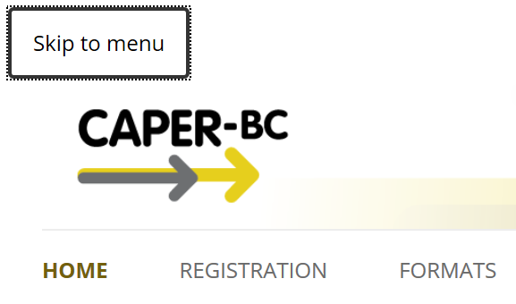

Slide 52
Skip Link Code Example
HTML
<a class="assistive-text" href="#site-navigation" title="Skip to menu">Skip to menu</a>
CSS
.assistive-text {
clip: rect(1px 1px 1px 1px);
/* IE6, IE7 */
clip: rect(1px, 1px, 1px, 1px);
position: absolute
!important;
}
.assistive-text:focus {
clip: auto !important;
display: block;
position: absolute;
z-index: 100000;
/* insert position, border,
color, font size, etc. */
}

Slide 53
ARIA

Slide 54
<nav> role = "navigation"

Slide 55
<body> <header role="banner"> <h1>site name</h1> <nav id=“menu” role="navigation"> <a href=“...”>Global Nav Link</a> <a href=“...”>Second Nav Link</a> <a href=“...”>Yet Another Nav Link</a> </nav> </header> <div id="content" role="main"> <article role="article"> <!-- your content, a blog post for example --> </article> </div> <div id="secondary" role="complementary"> <!-- typically your sidebar --> </div> <footer role="contentinfo"> copyright and other info </footer> </body>

Slide 56
Reference Material
The Paciello Group Blog
blog.paciellogroup.com
The Accessibility Project
a11yproject.com
ARIA for the Spec Impaired
ns4lib.com/aria-primer
Using ARIA in HTML
w3.org/TR/aria-in-html

Slide 57
Testing Your Website

Slide 58
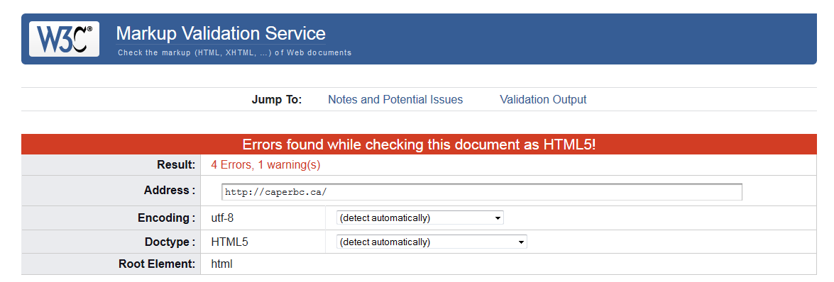
validator.w3.org

Slide 59
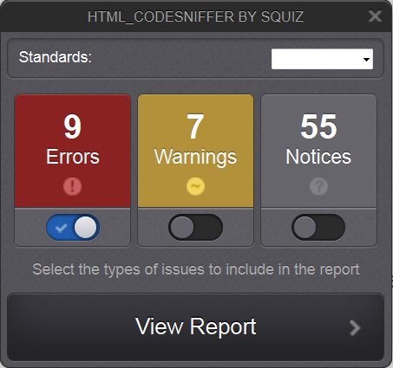
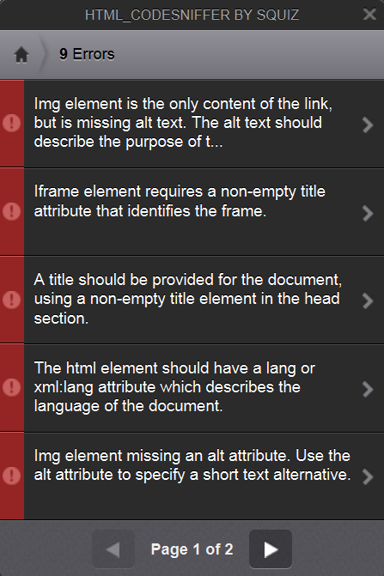
HTML Codesniffer
http://squizlabs.github.com/HTML_CodeSniffer/

Slide 60
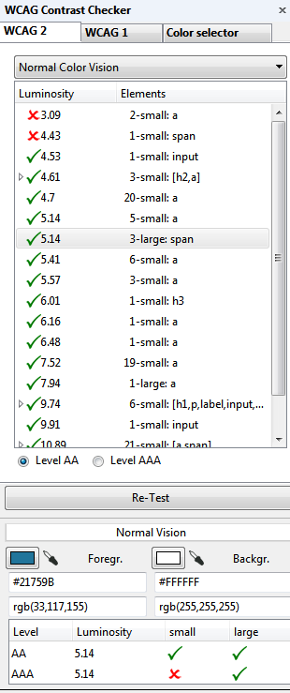
WCAG Contrast Checker

Slide 61
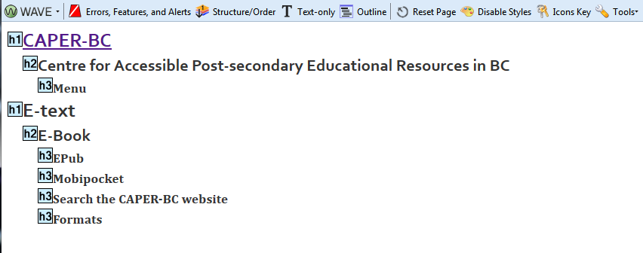
WAVE Toolbar
http://wave.webaim.org/toolbar/

Slide 62
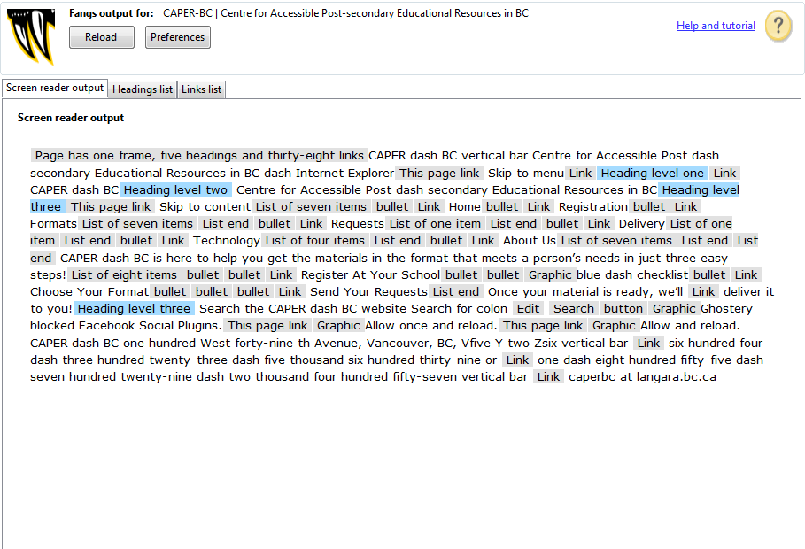

Slide 63
Humans are the problem

Slide 64
Keep It Simple

Slide 65
Content Guidelines
Use headers properly
Use descriptive links
Describe your Images
If you embed audio/video, add a link to the original
Be clear and concise

Slide 66
- Marcin Treder @marcintreder
I’ve learned that what matters [...]
is an actionable process — possible to use, adapted to the company’s culture and financially effective.
http://uxdesign.smashingmagazine.com/2012/08/29/beyond-wireframing-real-life-ux-design-process/

Slide 67
Take Aways

Slide 68
- Tim Berners-Lee @timbernerslee
The power of the Web is in its universality. Access by everyone regardless of disability is an essential aspect.
http://www.w3.org/standards/webdesign/accessibility ; CC BY NC SA http://www.flickr.com/photos/j-o-n-o/151830908/

Slide 69
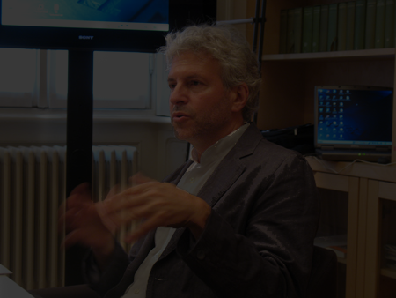
- Lennard Davis @lendavis
We’re all disabled
Book: Bending Over Backwards: Disability, Dismodernism and Other Difficult Positions
CC BY NC ND http://www.fondazionebassetti.org/en/focus/2010/07/a_man_his_history_and_his_dna.html

Slide 70
- Jonathan Lazar
Universal usability is simply good design.
Book: Universal usability: designing computer interfaces for diverse user populations
CC BY http://www.flickr.com/photos/marc_smith/6076488785/

Slide 71
Thank You
Cynthia Ng
@TheRealArty
about.me/cynthiang

